Slide 1
After Sessional I
Mansi A. Radke
09/10/2019
Information Retrieval - Winter-2019 - Mansi A. Radke
1

Slide 2
Index construction
Mansi A. Radke

Slide 3
Note
Assumption: Collection is static i.e. it never changes …. There are no additions or deletions to the collection
Desirable to keep entire index in RAM for performance reasons, however in many applications it is not feasible
Hard drive is much cheaper than the RAM. In 2010 1GB RAM costed 200 times of the cost of 1GB hard drive space. This difference might be even more today
An in memory index is 10 to 20 times faster than an on-disk index.
Hence throughout the chapter we focus on hybrid organizations of the index in which some parts of the index are kept in main memory and majority of the data are on the hard disk. We do so assuming that main memory is a scarce resource
09/10/2019
Information Retrieval - Winter-2019 - Mansi A. Radke
1

Slide 4
Index components
Dictionary
Posting lists
Note that for every query term in an incoming search query, the search engine first needs to locate the term’s posting list before it can start actually processing the query
It is the dictionary which provides a mapping between the terms and the location of their posting lists in the index
09/10/2019
Information Retrieval - Winter-2019 - Mansi A. Radke
1

Slide 5
Life cycle of an inverted index
Index construction
The text collection is processed sequentially, one token at a time, and a postings list is built for each term in the collection in an incremental fashion
Also called phase 1
The time required for this is called indexing time
Query processing
The information stored in the index built in the phase 1 is used to process search queries
Also called as phase 2
The time required for this is called as query time
09/10/2019
Information Retrieval - Winter-2019 - Mansi A. Radke
1

Slide 6
Dictionary
Dictionary is the central data structure that is used to manage the set of terms in a text collection
Provides mapping between index term and the location of its posting list
At query time locating the posting list if one of the first operations performed when processing an incoming keyword query
At indexing time, the dictionary’s lookup capability allows the search engine to quickly obtain the memory address of the inverted list for each incoming term and append a new posting at the end of that list
09/10/2019
Information Retrieval - Winter-2019 - Mansi A. Radke
1

Slide 7
Set of operations supported by the dictionary
Insert a new entry for term T
Find and return the entry for term T (if present)
Find and return the entries of all terms that start with a given prefix P
For e.g. prefix queries like “inform*” – all words that begin with prefix inform
09/10/2019
Information Retrieval - Winter-2019 - Mansi A. Radke
1

Slide 8
Size of the dictionary
For a typical natural language text collection, the size of the dictionary is very small compared to the total size of the index
Examples: GOV 2 copus 0.6 percent, Shakespeare corpus – 7%
(This is because of the Zipf’s law – assume for now as we will study it later)
Hence we assume that the dictionary is small enough to fit into the main memory
09/10/2019
Information Retrieval - Winter-2019 - Mansi A. Radke
1
Notes:
%
<number>

Slide 9
Two most common ways to realise an in-memory dictionary are:
A sort-based dictionary, in which all the terms that appear in the text collection are arranged in a sorted array or in a search tree, in lexicographical (i.e. alphabetical) order. Lookup operations are realised through tree traversals typically using a BST when the list is sorted
A hash based dictionary, in which each index term as a corresponding entry in a hash table. Collisions in the table (i.e. two terms are assigned the same hash value) are resolved using chaining
09/10/2019
Information Retrieval - Winter-2019 - Mansi A. Radke
1

Slide 10
Blocked Sort Based Indexing
Basic steps in constructing a non positional index are:
Make a pass through the collection collecting all term id - document id pairs
Sort the term id – document id pairs with term id as the dominant key and the document id as the secondary key
Organise the document ids for each term into a posting list
Compute the statistics like term and document frequency
For small collections, all this can happen in the memory. Our focus is on methods for large collections that require the use of secondary storage
Note: termIDs are represented as numbers instead of strings where each termID is a unique serial number
09/10/2019
Information Retrieval - Winter-2019 - Mansi A. Radke
1

Slide 11
09/10/2019
Information Retrieval - Winter-2019 - Mansi A. Radke
1

Slide 12
09/10/2019
Information Retrieval - Winter-2019 - Mansi A. Radke
1

Slide 13
09/10/2019
Information Retrieval - Winter-2019 - Mansi A. Radke
1

Slide 14
Merging – suppose 10 blocks
Open all the block files simultaneously
Maintain small read buffers for the 10 blocks which we are reading
A small write buffer for the final merged index which we are writing
In each iteration, the smallest term id is selected which has not been processed yet using a priority queue or similar data structure
All posting lists for this term id are read and merged
Merged list is written back to the disk
Each buffer is filled from its file when necessary
09/10/2019
Information Retrieval - Winter-2019 - Mansi A. Radke
1

Slide 15
Time complexity of BSBI
O(T Log T) where T is the number of term id – doc id pairs
The step with highest time complexity is sorting which takes O (T Log T) time
But, ParseNextBlock and MergeBlocks usually dominates time taken due to disk access time
09/10/2019
Information Retrieval - Winter-2019 - Mansi A. Radke
1

Slide 16
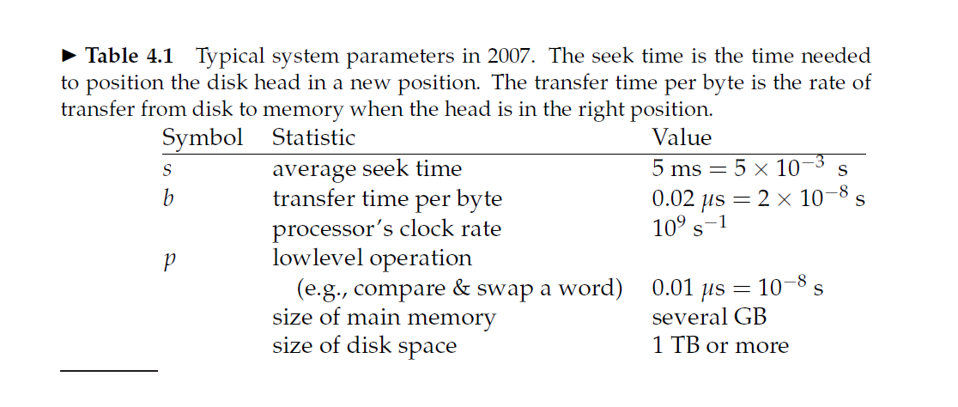
09/10/2019
Information Retrieval - Winter-2019 - Mansi A. Radke
1

Slide 17
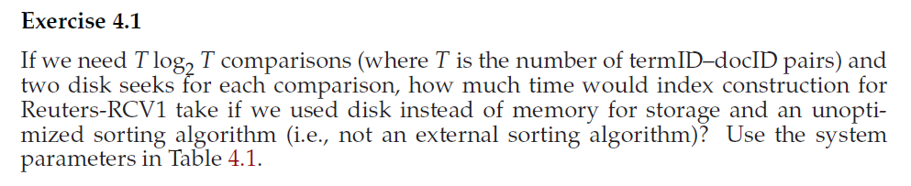
Solve the following question…
09/10/2019
Information Retrieval - Winter-2019 - Mansi A. Radke
1

Slide 18
Solution
An unoptimized sorting algorithm would be to have all the postings stored on the disk and transfer them back and forth from disk to memory to make comparisons
A trivial index construction would consist of these 2 steps:
Parsing the documents and creating the postings O(n)
Sorting the postings 2*n log n * diskseektime
For RCV1
N = 100,000,000 = 10^8
Step 2 dominates the total time by a large factor
Answer = 2 * 10^8 * log 10^8 * 5 * 10^-3 seconds
09/10/2019
Information Retrieval - Winter-2019 - Mansi A. Radke
1

Slide 19
Answer the following question…
How would you create the dictionary in blocked sort based indexing on the fly to avoid an extra pass through the data?
Solution: Simply accumulate the vocabulary in memory using a hash
09/10/2019
Information Retrieval - Winter-2019 - Mansi A. Radke
1

Slide 20
BSBI advantages and disadvantages
Advantage:
Excellent scaling properties
Disadvantage:
Needs a data structure for mapping terms to term ids. For very large collections this data structure does not fit into memory
09/10/2019
Information Retrieval - Winter-2019 - Mansi A. Radke
1

Slide 21
SPIMI (Single pass in memory indexing)
SPIMI uses terms instead of term ids
It writes a block of dictionary to the disk and starts a new dictionary for the next block
It can index collections of any size as long as disk space is available
09/10/2019
Information Retrieval - Winter-2019 - Mansi A. Radke
1

Slide 22
09/10/2019
Information Retrieval - Winter-2019 - Mansi A. Radke
1

Slide 23
Time complexity of SPIMI
O(T)
09/10/2019
Information Retrieval - Winter-2019 - Mansi A. Radke
1

Slide 24
BSBI versus SPIMI
SPIMI does not collect term id –doc id pairs
SPIMI does not need to sort the term id document id pairs
SPIMI adds postings directly to its posting list
SPIMI uses a dynamic posting list (i.e. its size is adjusted as it grows)
SPIMI keeps track of the term a postings list belongs to and no term ids are stored due to which the blocks that individual calls of SPIMI-INVERT can process are larger and so the index construction process as a whole is more eficient
09/10/2019
Information Retrieval - Winter-2019 - Mansi A. Radke
1

Slide 25
Distributed Indexing
Collections are huge
Indexing cannot be done on single machine (e.g world wide web)
Hence distributed indexing algorithms used
Distributed index is partitioned across several machines
Acccording to term
or
According to document
In the next slides we discuss both these partitioning techniques
09/10/2019
Information Retrieval - Winter-2019 - Mansi A. Radke
1

Slide 26
09/10/2019
Information Retrieval - Winter-2019 - Mansi A. Radke
1

Slide 27
Term partitioning and document partitioning
In this chapter we will discuss about distributed indexing for term partitioned index
In a document-partitioned index, each node holds an index
for a subset of the documents in the collection. For instance, the index maintained by node 2
in Figure 14.1(a) contains the following docid lists:
L1 = 4, 6, L2 = 5, L4 = 4, L5 = 6, L7 = 4, 6.
In a term-partitioned index, each node is responsible for a subset of the terms in the collection.
The index stored in node 1 in Figure 14.1(b) contains the following lists:
L1 = 1, 3, 4, 6, 9, L2 = 2, 5, L3 = 2, 3, 8.
09/10/2019
Information Retrieval - Winter-2019 - Mansi A. Radke
1

Slide 28
MapReduce
MapReduce is an architecture for distributed computing
Master node
Worker nodes
Master node directs the process of assigning and reassigning tasks to individual worker nodes
The map and reduce phases of MapReduce split up the computing job into chunks that standard machines can process in a short time\
The chunks should be not too small and not too large
09/10/2019
Information Retrieval - Winter-2019 - Mansi A. Radke
1

Slide 29
Role of master node
Assigns and reassigns tasks to worker nodes
As machine finishes one split, it is assigned next one
If machine dies or has hardware problems, the split it is working on is assigned to another machine
09/10/2019
Information Retrieval - Winter-2019 - Mansi A. Radke
1

Slide 30
Key value pairs indexing are <term id, doc id >
MAP Phase:
mapping splits of input data to key value pairs
The map phase writes its output to local intermediate files called as segment files
Reduce Phase:
All values of a given key get stored together
the keys are partitioned into j term partitions
Note: The term partitions are defined by the person who operates the indexing system
09/10/2019
Information Retrieval - Winter-2019 - Mansi A. Radke
1

Slide 31
Parsers and inverters
Parsers and inverters are not separate sets of machines.
The master identifies idle machines and assigns tasks to them.
The same machine can be a parser in the map phase and an inverter in the reduce phase.
And there are often other jobs that run in parallel with index construction, so in between being a parser and an inverter a machine might do some crawling or another unrelated task.
09/10/2019
Information Retrieval - Winter-2019 - Mansi A. Radke
1

Slide 32
09/10/2019
Information Retrieval - Winter-2019 - Mansi A. Radke
1

Slide 33
Problem on map reduce
09/10/2019
Information Retrieval - Winter-2019 - Mansi A. Radke
1

Slide 34
Computing scores in a complete search system
Mansi A. Radke
09/10/2019
Information Retrieval - Winter-2019 - Mansi A. Radke
1

Slide 35
Efficient scoring and ranking in a complete search system
For the purpose of ranking the documents matching a given query, we are really interested in the relative (rather than absolute) scores of the documents in the collection. To this end, it suffices to compute the cosine similarity from each document unit vector v(d) to V (q) (in which all non-zero components of the query vector are set to 1), rather than to the unit vector v(q) for any two documents d1 and d2.
For any document d, the cosine similarity V (q) · v(d) is the weighted sum, over all terms in the query q, of the weights of those terms in d.
09/10/2019
Information Retrieval - Winter-2019 - Mansi A. Radke
1

Slide 36
Efficient scoring and ranking in a complete search system
Given these scores, the final step before presenting results to a user is to pick out the K highest-scoring documents. While one could sort the complete set of scores, a better approach is to use a heap to retrieve only the top K documents in order
Where J is the number of documents with non-zero cosine scores, constructing such a heap can be performed in 2J comparison steps, following which each of the K highest scoring documents can be “read off” the heap with log J comparison steps
09/10/2019
Information Retrieval - Winter-2019 - Mansi A. Radke
1

Slide 37
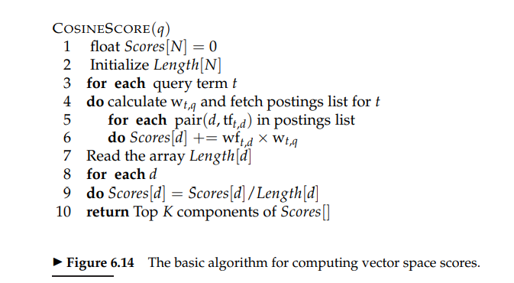
09/10/2019
Information Retrieval - Winter-2019 - Mansi A. Radke
1

Slide 38
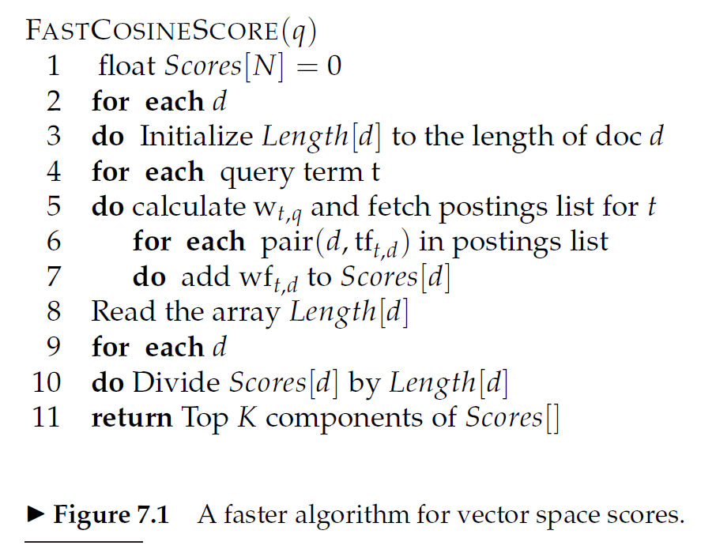
09/10/2019
Information Retrieval - Winter-2019 - Mansi A. Radke
1

Slide 39
Inexact top-k document retrieval
In most applications, it suffices to retrieve k documents whose scores are very close to those of the k – best
By this we can potentially avoid computing the scores for most of N documents in the collection
We use some heuristics and find a set A of documents that are potential candidates for top k (k < |A| << N)
Note that A does not necessarily contain the k top scoring documents for the query, but is likely to have many documents with scores near to those of top k
Return the top k scoring documents in A
09/10/2019
Information Retrieval - Winter-2019 - Mansi A. Radke
1

Slide 40
Index Elimination
For a multiterm query, we only consider documents containing at least one of the query terms
Additional Heuristics
We consider only those documents containing terms whose idf exceeds a preset threshold
Thus in the postings traversal, we only traverse the postings for terms with high idf. This has a fairly significant benefit as the postings list for low idf terms are generally long. With these removed, the set of documents for which we compute the cosine scores is greatly reduced
In short low idf terms are treated like stop words
The cut-off threshold can be adopted in query dependent manner
We contain the documents that contain many (as a special case, all) the query terms
Danger of this is : We may end up in fewer than k candidate documents in the output
09/10/2019
Information Retrieval - Winter-2019 - Mansi A. Radke
1

Slide 41
Champion Lists
Champion lists = fancy lists = top docs
The idea is to precompute, for each term t in the dictionary, the set of r documents with highest weights for t The value of r is chosen in advance
For tf-idf weighting, these would be the r documents with the highest tf values for term t. We call this set of r documents the champion list for term t.
Now, given a query q we create a set A as follows: we take the union of the champion lists for each of the terms comprising q.
We now restrict cosine computation to only the documents in A.
A critical parameter in this scheme is the value r, which is highly application dependent. Intuitively, r should be large compared with K, especially if we use any form of the index elimination
09/10/2019
Information Retrieval - Winter-2019 - Mansi A. Radke
1

Slide 42
Issue In champion lists
One issue here is that the value r is set at the time of index construction, whereas K is application dependent and may not be available until the query is received; as a result we may (as in the case of index elimination) find ourselves with a set A that has fewer than K documents. There is no reason to have the same value of r for all terms in the dictionary; it could for instance be set to be higher for rarer terms.
Note : r need not be same for all terms in dictionary. R could be greater for rarer terms
09/10/2019
Information Retrieval - Winter-2019 - Mansi A. Radke
1

Slide 43
Static Quality scores and ordering
In many search engines, we have available a measure of quality g(d) for each document d that is query independent and thus static
Static quality measure has a value between 0 and 1
Example: In context of news stories on the web, g(d) may be derived from the number of favourable reviews if the story by web surfers
Net score = combination of (g(d) and query dependent score)
For e.g. net score(q,d) = g(d) + cosine score of d with respect to q
Both components can have equal contributions assuming each is between 0 and 1 .
Other relative weightings are also possible, the effectiveness of our heuristics depends on the specific relative weighting
09/10/2019
Information Retrieval - Winter-2019 - Mansi A. Radke
1

Slide 44
Ideas for static quality scores and ranking
Idea 1:
Consider ordering the documents in the posting list for each term by decreasing order of g(d)
Idea 2:
Extension of champion lists
Global champion list: for a well chosen r, we maintain for each term ‘t’, a global champion list of r documents with highest values of g(d) + tf-idf(t,d)
At query time, we only compute the net scores for documents in the union of global champion lists
09/10/2019
Information Retrieval - Winter-2019 - Mansi A. Radke
1

Slide 45
Ideas for static quality scores and ranking
Idea 3:
We maintain for each term t, two posting lists consisting of disjoint sets of documents, each sorted by g(d) values
First list -> high-> m docs with highest tf values for t
Second list -> low-> remaining docs containing t
While processing a query, scan only the high lists. If we get k docs in the process terminate. If not, go to the low lists
09/10/2019
Information Retrieval - Winter-2019 - Mansi A. Radke
1

Slide 46
Impact ordering
In all the postings lists described thus far, we order the documents consistently by some common ordering: typically by document ID or by static quality scores.
Such a common ordering supports the concurrent traversal of all of the query terms’ postings lists, computing the score for each document as we encounter it. Computing scores in this manner is sometimes referred to as document-at-atime scoring.
We will now introduce a technique for inexact top-K retrieval in which the postings are not all ordered by a common ordering, thereby precluding such a concurrent traversal. We will therefore require scores to be “accumulated” one term at a time so that we have term-at-a-time scoring.
The idea is to order the documents d in the postings list of term t by decreasing order of tft,d. Thus, the ordering of documents will vary from one postings list to another, and we cannot compute scores by a concurrent traversal of the postings lists of all query terms.
09/10/2019
Information Retrieval - Winter-2019 - Mansi A. Radke
1

Slide 47
Impact ordering
Given postings lists ordered by decreasing order of tft,d, two ideas have been found to significantly lower the number of documents for which we accumulate scores:
(1) when traversing the postings list for a query term t, we stop after considering a prefix of the postings list – either after a fixed number of documents r have been seen, or after the value of tft,d has dropped below a threshold;
(2) when accumulating scores, we consider the query terms in decreasing order of idf, so that the query terms likely to contribute the most to the final scores are considered first.
This latter idea too can be adaptive at the time of processing a query: as we get to query terms with lower idf, we can determine whether to proceed based on the changes in document scores from processing the previous query term. If these changes are minimal, we may omit accumulation from the remaining query terms, or alternatively process shorter prefixes of their postings lists.
09/10/2019
Information Retrieval - Winter-2019 - Mansi A. Radke
1

Slide 48
Impact ordering
We may also implement a version of static ordering in which each postings list is ordered by an additive combination of static and query-dependent scores. We would again lose the consistency of ordering across postings, thereby having to process query terms one at time accumulating scores for all documents as we go along. Depending on the particular scoring function, the postings list for a document may be ordered by other quantities than term frequency; under this more general setting, this idea known as impact ordering.
09/10/2019
Information Retrieval - Winter-2019 - Mansi A. Radke
1

Slide 49
Cluster Pruning
09/10/2019
Information Retrieval - Winter-2019 - Mansi A. Radke
1

Slide 50
Cluster pruning
09/10/2019
Information Retrieval - Winter-2019 - Mansi A. Radke
1

Slide 51
Query processing in cluster pruning
1. Given a query q, find the leader L that is closest to q. This entails computing cosine similarities from q to each of the √N leaders.
2. The candidate set A consists of L together with its followers. We compute the cosine scores for all documents in this candidate set.
Note: The use of randomly chosen leaders for clustering is fast and likely to reflect the distribution of the document vectors in the vector space: a region of the vector space that is dense in documents is likely to produce multiple leaders and thus a finer partition into sub-regions.
09/10/2019
Information Retrieval - Winter-2019 - Mansi A. Radke
1

Slide 52
Variations of cluster pruning
Variations of cluster pruning introduce additional parameters b1 and b2, both of which are positive integers. In the pre-processing step we attach
each follower to its b1 closest leaders, rather than a single closest leader.
At query time we consider the b2 leaders closest to the query q.
Clearly, the basic scheme above corresponds to the case b1 = b2 = 1. Further, increasing b1 or b2 increases the likelihood of finding K documents that are more likely to be in the set of true top-scoring K documents, at the expense of more computation.
09/10/2019
Information Retrieval - Winter-2019 - Mansi A. Radke
1

Slide 53
Points to ponder!
When discussing champion lists, we simply used the r documents with the largest tf values to create the champion list for t. But when considering global champion lists, we used idf as well, identifying documents with the largest values of g(d) +tf-idft,d. Why do we differentiate between these two cases?
09/10/2019
Information Retrieval - Winter-2019 - Mansi A. Radke
1

Slide 54
When query = a single term t, union of champion lists for each term is the same as that of t. Ranking by netscore=g(d)+ tf(d) idf(t,d) is equivalent to Ranking by netscore=g(d)+ tf(d) So use of global champion list within m=K suffices for finding K highest scoring documents.
09/10/2019
Information Retrieval - Winter-2019 - Mansi A. Radke
1

Slide 55
Points to Ponder!
If we were to only have one-term queries, explain why the use of global champion lists with r = K suffices for identifying the K highest scoring documents. What is a simple modification to this idea if we were to only have s-term queries for any fixed integer s > 1?
For a one-term query, the ordering of documents is independent of of the term in the query. It only depends on the weight of the term in the documents. The truncated weight-ordered postings list contains the K documents with the highest weights. Thus, it is identical to the ranked list for the one-term query.
09/10/2019
Information Retrieval - Winter-2019 - Mansi A. Radke
1

Slide 56
Explain how the common global ordering by g(d) values in all high and low lists helps make the score computation efficient.
In the general case, the postings list of query terms are traversed to find the documents which contains all or most of query terms and then scores are calculated for these documents to find the top K. Thus more importance is given to v(q) .v(d) in the short listing stage and g(d)is accounted for later. If common global ordering by g(d) is implemented, not just it increases the efficiency of results but also less documents would have to undergo score calculation process thereby reducing some work through at the cost of initial ordering.
09/10/2019
Information Retrieval - Winter-2019 - Mansi A. Radke
1

Slide 57
Points to ponder!
The nearest-neighbor problem in the plane is the following: given a set of N data points on the plane, we preprocess them into some data structure such that, given a query point Q, we seek the point in N that is closest to Q in Euclidean distance. Clearly cluster pruning can be used as an approach to the nearest-neighbor problem in the plane, if we wished to avoid computing the distance from Q to every one of the query points. Devise a simple example on the plane so that with two leaders, the answer returned by cluster pruning is incorrect (it is not the data point closest to Q).
09/10/2019
Information Retrieval - Winter-2019 - Mansi A. Radke
1

Slide 58
Solution
09/10/2019
Information Retrieval - Winter-2019 - Mansi A. Radke
1

Slide 59
Points to Ponder!
Explain how the postings intersection algorithm first introduced in Section 1.3 can be adapted to find the smallest integer ω that contains all query terms.
Move concurrently through the positional postings of all query terms, until a document D is found that contains all the query terms.
1. Move the cursor on each postings to the first positional occurrence of the term.
2. Measure the window size to be the distance between the leftmost and rightmost cursors.
3. Repeat the following until some cursor exits document D:
4. Pick the left-most cursor among all postings and move right to the next occurrence; measure the window size as above.
5. Output the minimum of all of these measurements.
09/10/2019
Information Retrieval - Winter-2019 - Mansi A. Radke
1

Slide 60
Adapt this procedure in previous question to work when not all query terms are present in a document
a. Check whether all k query terms are present in a document. If yes, apply algorithm of k nearest neighbor cluster pruning.
b. If k>=2,Make all possible combinations of (k-1) query terms and check for a document D which contains all terms of any of the combinations.
If yes, change the query[] to exclude all query terms not in that combination and recur.
If not, repeat step b until a document D is found. If k=1, return all documents containing the remaining query term.
09/10/2019
Information Retrieval - Winter-2019 - Mansi A. Radke
1

Slide 61
Evaluation in IR
Mansi A. Radke

Slide 62
3 key things !
To measure ad hoc information retrieval effectiveness in the standard way, we need a test collection consisting of three things:
1. A document collection
2. A test suite of information needs, expressible as queries
3. A set of relevance judgments, standardly a binary assessment of either relevant or nonrelevant for each query-document pair.

Slide 63
Gold standard / Ground truth
With respect to a user information need, a document in the test collection is given a binary classification as either relevant or nonrelevant. This decision is referred to as the gold standard or ground truth judgment of relevance.
This process is called as Annotation
Gold labour indicates the people who do this annotation

Slide 64
How many queries?
As a rule of thumb, 50 information needs has usually been found to be a sufficient minimum.
(Whatever be the size of the corpus )

Slide 65
Relevance is assessed relative to an information need, not a query
A document is relevant if it addresses the stated information need, not because it just happens to contain all the words in the query. This distinction is often misunderstood in practice, because the information need is not overt

Slide 66
Development test collection
Many systems contain various weights (often known as parameters) that can be adjusted to tune system performance. It is wrong to report results on a test collection which were obtained by tuning these parameters to maximize performance on that collection. That is because such tuning overstates the expected performance of the system, because the weights will be set to maximize performance on one particular set of queries rather than for a random sample of queries. In such cases, the correct procedure is to have one or more development test collections, and to tune the parameters on the development test collection. The tester then runs the system with those weights on the test collection and reports the results on that collection as an unbiased estimate of performance.

Slide 68
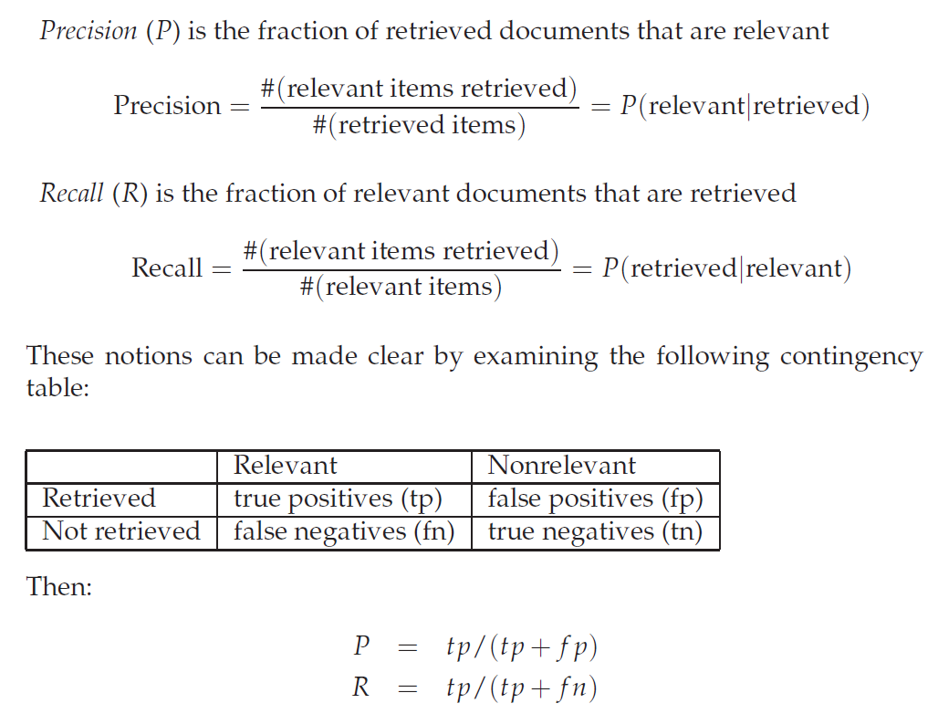
Evaluation in unranked retrieval

Slide 69
Accuracy
An obvious alternative that may occur to the reader is to judge an information retrieval system by its accuracy, that is, the fraction of its classifications that are correct.
Accuracy = (tp + tn)/(tp + f p + f n + tn).

Slide 70
Why accuracy is not a good measure?
There is a good reason why accuracy is not an appropriate measure for information retrieval problems. In almost all circumstances, the data is extremely skewed: normally over 99.9% of the documents are in the nonrelevant category. A system tuned to maximize accuracy can appear to perform well by simply deeming all documents nonrelevant to all queries. Even if the system is quite good, trying to label some documents as relevant will almost always lead to a high rate of false positives. However, labeling all documents as nonrelevant is completely unsatisfying to an information retrieval system user.

Slide 71
Why precision and recall both?
The advantage of having the two numbers for precision and recall is that one is more important than the other in many circumstances. Typical web surfers would like every result on the first page to be relevant (high precision) but have not the slightest interest in knowing let alone looking at every document that is relevant. In contrast, various professional searchers such as paralegals and intelligence analysts are very concerned with trying to get as high recall as possible, and will tolerate fairly low precision results in order to get it. Individuals searching their hard disks are also often interested in high recall searches.

Slide 72
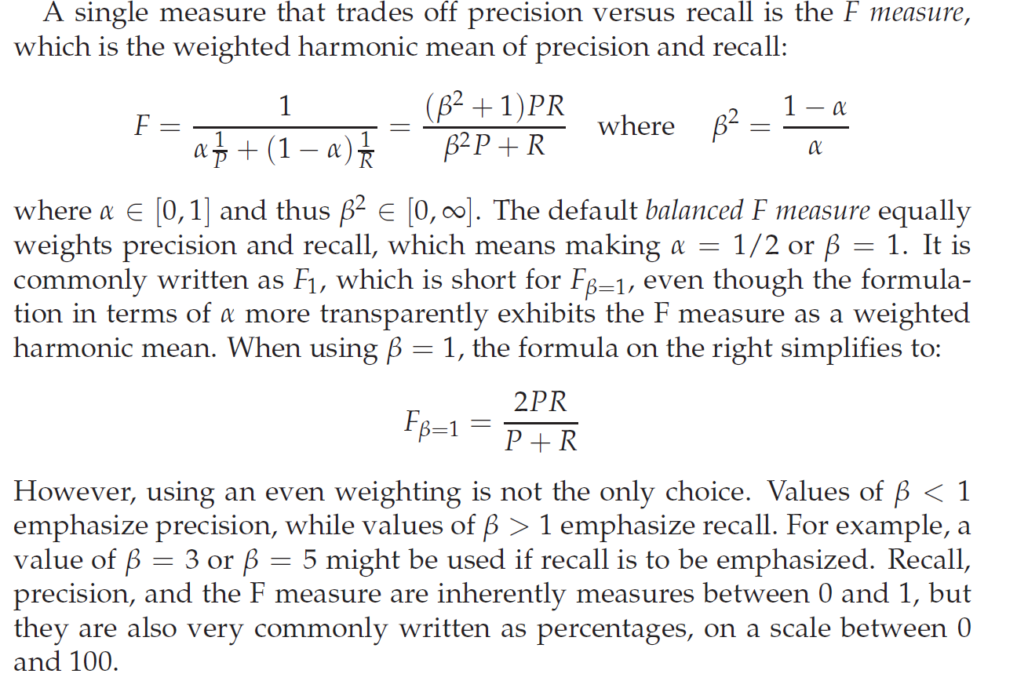
F1 measure

Slide 73
Values of Beta
<1
>1
=1

Slide 74
Arithmetic, geometric and harmonic mean
Arithmetic mean of 2 and 18 is 10
What is the Geometric Mean of 2 and 18? First we multiply them: 2 × 18 = 36. Then (as there are two numbers) take the square root: √36 = 6.
Harmonic mean of 2 and 18 is
½ + 1/18
= 10/18
As there are 2 numbers we divide by 2
10/(18*2)
Then take reciprocal = reciprocal of 10/36 = 36/10 = 3.6

Slide 75
Why harmonic mean?
we can always get 100% recall by just returning all documents, and therefore we can always get a 50% arithmetic mean by the same process. This strongly suggests that the arithmetic mean is an unsuitable measure to use.
In contrast, if we assume that 1 document in 10,000 is relevant to the query, the harmonic mean score of this strategy is 0.02%.
The harmonic mean is always less than or equal to the arithmetic mean and the geometric mean.
When the values of two numbers differ greatly, the harmonic mean is closer to their minimum than to their arithmetic mean

Slide 76
Evaluation of ranked retrieval
In a ranked retrieval context, appropriate sets of retrieved documents are naturally given by the top k retrieved documents. For each such set, precision and recall values can be plotted to give a precision-recall curve, such as the one shown in next slide
Precision-recall curves have a distinctive saw-tooth shape: if the (k + 1)th document retrieved is nonrelevant then recall is the same as for the top k documents, but precision has dropped. If it is relevant, then both precision and recall increase, and the curve jags up and to the right.

Slide 77
Precision recall curve

Slide 78
It is often useful to remove these jiggles and the standard way to do this is with an interpolated precision: the interpolated precision pinterp at a certain recall level r is defined as the highest precision found for any recall level r′ ≥ r:

Slide 79
Interpolated precision

Slide 80
11 point interpolated average precision
For each information need, the interpolated precision is measured
at the 11 recall levels of 0.0, 0.1, 0.2, . . . , 1.0. For the precision-recall curve. For each recall level, we then calculate the arithmetic mean of the interpolated precision at that recall level for each information need in the test collection

Slide 81
Average precision
average of the precision value obtained for the set of top k documents existing after each relevant document is retrieved

Slide 82
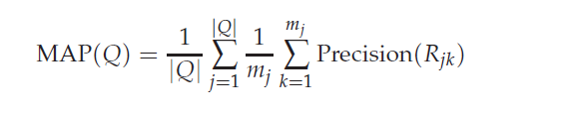
Mean average precision

Slide 83
Note:
Using MAP, fixed recall levels are not chosen, and there is no interpolation

Slide 84
PRECISION AT k
Precision at the kth document

Slide 85
R-PRECISION
Count the number of relevant documents say k
Calculate the precision at that point i.e. kth document.
Report it as the R-precision

Slide 86
BREAK-EVEN POINT
When P = R!

Slide 87
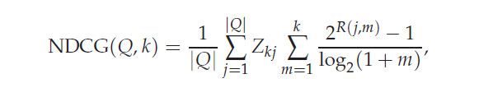
Normalised discounted cumulative gain

Slide 88
In large collection settings, use of binary assessments failed to
distinguish “very good” and “fair” retrieval systems, so NDCG is used

Slide 90
Difficulty in IR
Information Retrieval is an Empirical Discipline
•Lack of “Correct answer”
•Requiring thorough and careful evaluation

Slide 91
Relevance
“Something (A) is relevant to a task (T) if it increases the likelihood of accomplishing the goal (G), which is implied by T.”[Hjørland & Sejer Christensen, 2002]
Is subjective - and not entirely so!
• A document is judged relevant within the context of the query (or more precisely, the information need)
• Who judges?
• What is useful?

Slide 92
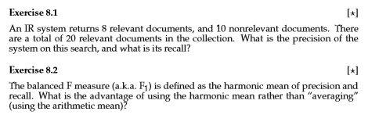
Problems

Slide 93
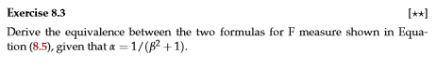

Slide 94
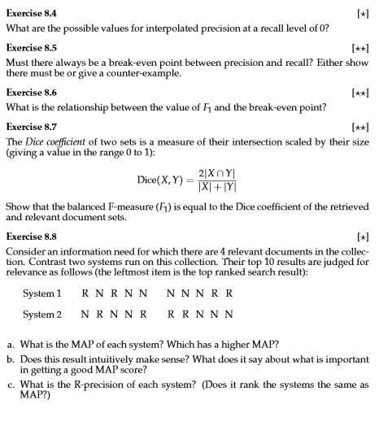

Slide 95
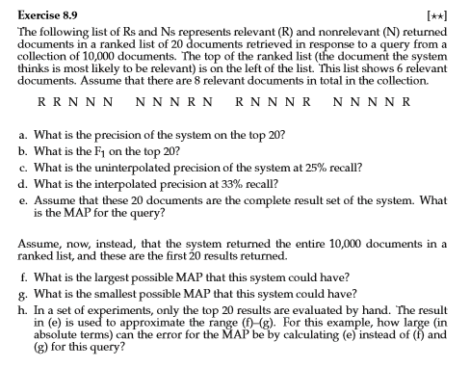

Slide 96
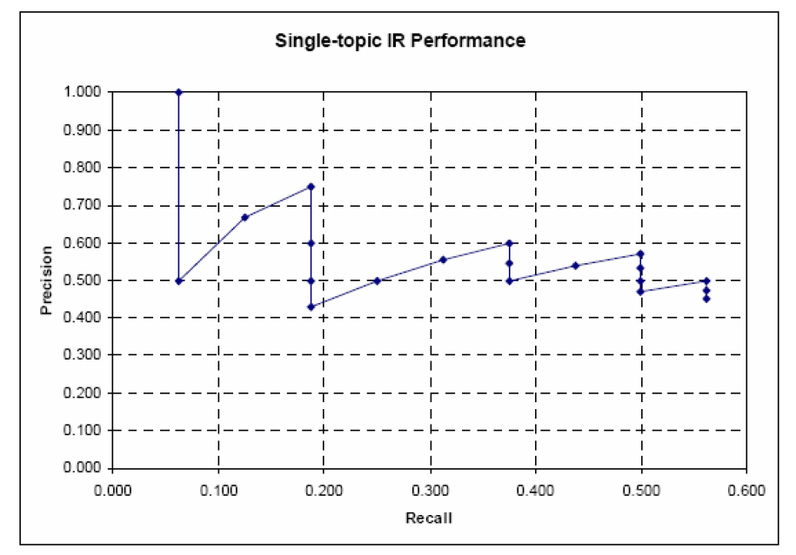
The following is the uninterpolated Precision-Recall Graph of an IR system, for one topic. You know that 20 hits were retrieved, and that there are 16 relevant documents for this topic (not all of which are retrieved).

Slide 98
Pooling
For large modern collections, it is usual for relevance to be assessed only for a subset of the documents for each query. The most standard approach is pooling, where relevance is assessed over a subset of the collection that is formed from the top k documents returned by a number of different IR systems (usually the ones to be evaluated), and perhaps other sources such as the results of Boolean keyword searches or documents found by expert searchers in an interactive process.

Slide 99
Kappa measure

Slide 100
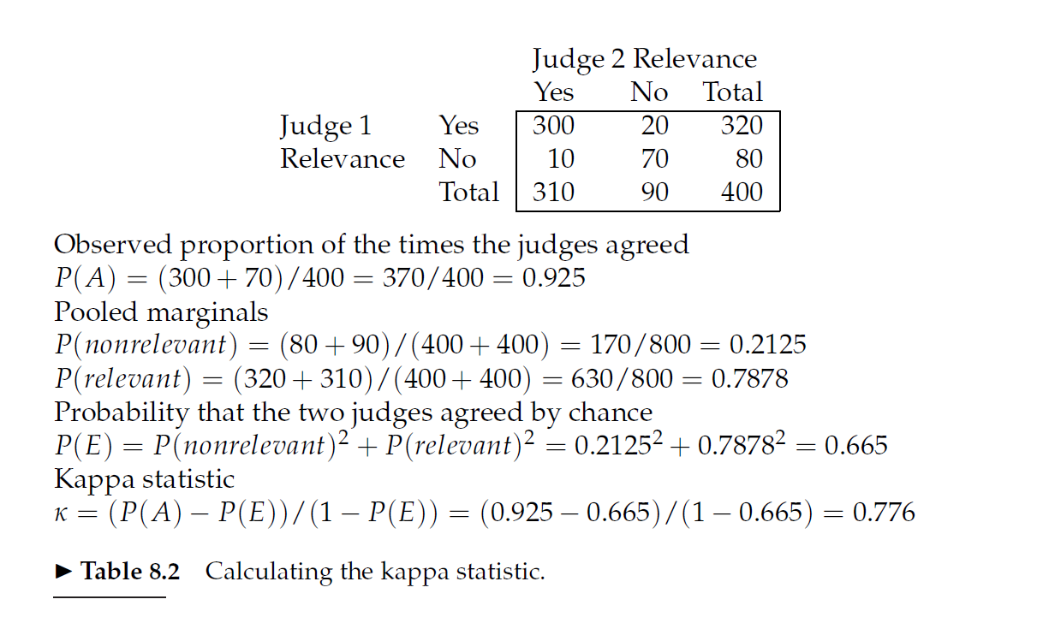

Slide 101
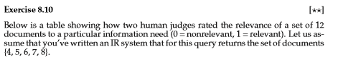
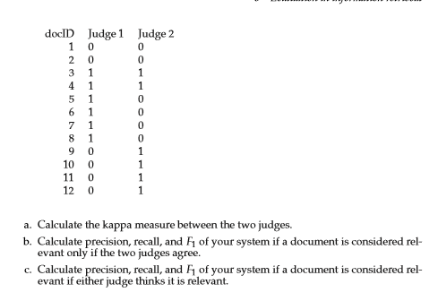

Slide 102
Relevance Feedback in Information retrieval
Synonymy
E.g. aircraft and airplane
Global vs Local methods
Global methods are techniques for expanding or reformulating query terms independent of the query and results returned from it, so that changes in the query wording will cause the new query to match other semantically similar terms
Query expansion with Thesaurus or wordnet
Query expansion through spelling correction
Automatic thesaurus generation
Local methods
Relevance feedback
Pseudo relevance feedback
Indirect relevance feedback
09/10/2019
Information Retrieval - Winter-2019 - Mansi A. Radke
1

Slide 103
Relevance feedback process
• The user issues a (short, simple) query.
• The system returns an initial set of retrieval results.
• The user marks some returned documents as relevant or nonrelevant.
• The system computes a better representation of the information need based on the user feedback.
• The system displays a revised set of retrieval results.
Relevance feedback can go through one or more iterations of this sort.
09/10/2019
Information Retrieval - Winter-2019 - Mansi A. Radke
1

Slide 104
The idea behind relevance feedback
The process exploits the idea that it may be difficult to formulate a good query when you don’t know the collection well, but it is easy to judge particular documents, and so it makes sense to engage in iterative query refinement of this sort.
In such a scenario, relevance feedback can also be effective in tracking a user’s evolving information need:
seeing some documents may lead users to refine their understanding of the information they are seeking.
E.g. Image retrieval
09/10/2019
Information Retrieval - Winter-2019 - Mansi A. Radke
1

Slide 105
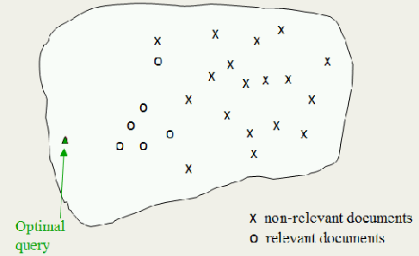
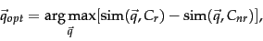
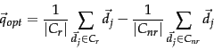
Rocchio Algorithm
Move the centroid towards set
of relevant documents and
away from non relevant
documents
09/10/2019
Information Retrieval - Winter-2019 - Mansi A. Radke
1

Slide 106
Revised query is more close to the optimal query!
09/10/2019
Information Retrieval - Winter-2019 - Mansi A. Radke
1

Slide 107
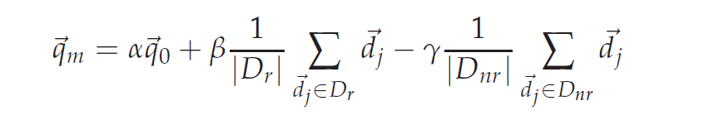
Formula for modified query vector
Relevance feedback can improve both recall and precision. But, in practice, it has been shown to be most useful for increasing recall in situations where recall is important. This is partly because the technique expands the query, but it is also partly an effect of the use case: when they want high recall, users can be expected to take time to review results and to iterate on the search.
09/10/2019
Information Retrieval - Winter-2019 - Mansi A. Radke
1

Slide 108
Positive vs negative feedback
Positive feedback also turns out to be much more valuable than negative feedback, and so most IR systems set γ < β. Reasonable values might be α = 1, β = 0.75, and γ = 0.15. In fact, many systems, such as the image search system in Figure 9.1, allow only positive feedback, which is equivalent to setting γ = 0. Another alternative is to use only the marked nonrelevant document which received the highest ranking from the IR system as negative feedback (here, |Dnr| = 1 ). While many of the experimental results comparing various relevance feedback variants are rather inconclusive
some studies have suggested that this variant, called Ide dec-hi is the most effective or at least the most consistent performer.
09/10/2019
Information Retrieval - Winter-2019 - Mansi A. Radke
1

Slide 109
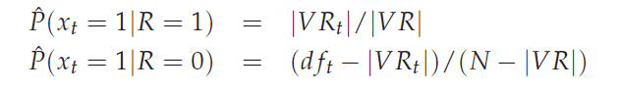
Probabilistic relevance feedback
Rather than reweighting the query in a vector space, if a user has told us some relevant and nonrelevant documents, then we can proceed to build a classifier. One way of doing this is with a Naive Bayes probabilistic model. If R is a Boolean indicator variable expressing the relevance of a document, then we can estimate P(xt = 1|R), the probability of a term t appearing in a document, depending on whether it is relevant or not, as:
09/10/2019
Information Retrieval - Winter-2019 - Mansi A. Radke
1

Slide 110
When does relevance feedback work? Assumptions behind relevance feedback
Firstly, the user has to have sufficient knowledge to be able to make an initial query which is at least somewhere close to the documents they desire.
Secondly, the relevance feedback approach requires relevant documents to be similar to each other. That is, they should cluster. Ideally, the term distribution in all relevant documents will be similar to that in the documents marked by the users, while the term distribution in all nonrelevant documents will be different from those in relevant documents. Things will work well if all relevant documents are tightly clustered around a single prototype, or, at least, if there are different prototypes, if the relevant documents have significant vocabulary overlap, while similarities between relevant and nonrelevant documents are small. Implicitly, the Rocchio relevance feedback model treats relevant documents as a single cluster, which it models via the centroid of the cluster. This approach does not work as well if the relevant documents are a multimodal class, that is, they consist of several clusters of documents within the vector space.
09/10/2019
Information Retrieval - Winter-2019 - Mansi A. Radke
1

Slide 111
Why relevance feedback fails?
Relevance feedback is not necessarily popular with users. Users are often reluctant to provide explicit feedback, or in general do not wish to prolong the search interaction.
Furthermore, it is often harder to understand why a particular document was retrieved after relevance feedback is applied.
Relevance feedback can also have practical problems.
The long queries that are generated by straightforward application of relevance feedback techniques are inefficient for a typical IR system.
This results in a high computing cost for the retrieval and potentially long response times for the user.
A partial solution to this is to only reweight certain prominent terms in the relevant documents, such as perhaps the top 20 terms by term frequency. Some experimental results have also suggested that using a limited number of terms like this may give better results (Harman 1992) though other work has suggested that using more terms is better in terms of retrieved document quality
09/10/2019
Information Retrieval - Winter-2019 - Mansi A. Radke
1

Slide 112
Cases where relevance feedback alone is not sufficient include:
Misspellings. If the user spells a term in a different way to the way it is spelled in any document in the collection, then relevance feedback is unlikely to be effective. This can be addressed by the spelling correction techniques.
Cross-language information retrieval. Documents in another language are not nearby in a vector space based on term distribution. Rather, documents in the same language cluster more closely together.
Mismatch of searcher’s vocabulary versus collection vocabulary. If the user searches for laptop but all the documents use the term notebook computer, then the query will fail, and relevance feedback is again most likely ineffective
09/10/2019
Information Retrieval - Winter-2019 - Mansi A. Radke
1

Slide 113
Evaluation of relevance feedback
Interactive relevance feedback can give very substantial gains in retrieval performance. Empirically, one round of relevance feedback is often very useful. Two rounds is sometimes marginally more useful.
Successful use of relevance feedback requires enough judged documents, otherwise the process is unstable in that it may drift away from the user’s information need.
Accordingly, having at least five judged documents is recommended.
09/10/2019
Information Retrieval - Winter-2019 - Mansi A. Radke
1

Slide 114
Evaluation of relevance feedback
The obvious first strategy is to start with an initial query q0 and to compute a precision-recall graph. Following one round of feedback from the user, we compute the modified query qm and again compute a precision-recall graph. Here, in both rounds we assess performance over all documents in the collection, which makes comparisons straightforward. If we do this, we find spectacular gains from relevance feedback: gains on the order of 50%inmean average precision.
But unfortunately it is cheating. The gains are partly due to the fact that known relevant documents (judged by the user) are now ranked higher.
Fairness demands that we should only evaluate with respect to documents not seen by the user
09/10/2019
Information Retrieval - Winter-2019 - Mansi A. Radke
1

Slide 115
Evaluation of relevance feedback
A second idea is to use documents in the residual collection (the set of documents minus those assessed relevant) for the second round of evaluation.
This seems like a more realistic evaluation. Unfortunately, the measured performance can then often be lower than for the original query. This is particularly the case if there are few relevant documents, and so a fair proportion of them have been judged by the user in the first round.
The relative performance of variant relevance feedback methods can be validly compared, but it is difficult to validly compare performance with and without relevance feedback because the collection size and the number of relevant documents changes from before the feedback to after it.
09/10/2019
Information Retrieval - Winter-2019 - Mansi A. Radke
1

Slide 116
Evaluation of relevance feedback
A third method is to have two collections, one which is used for the initial query and relevance judgments, and the second that is then used for comparative evaluation. The performance of both q0 and qm can be validly compared on the second collection.
Perhaps the best evaluation of the utility of relevance feedback is to do user studies of its effectiveness, in particular by doing a time-based comparison:
how fast does a user find relevant documents with relevance feedback vs. another strategy (such as query reformulation), or alternatively, how many relevant documents does a user find in a certain amount of time. Such notions of user utility are fairest and closest to real system usage.
09/10/2019
Information Retrieval - Winter-2019 - Mansi A. Radke
1

Slide 117
Pseudo relevance feedback
Pseudo relevance feedback, also known as blind relevance feedback, provides a method for automatic local analysis. It automates the manual part of relevance feedback, so that the user gets improved retrieval performance without an extended interaction. The method is to do normal retrieval to find an initial set of most relevant documents, to then assume that the top k ranked documents are relevant, and finally to do relevance feedback as before under this assumption.
09/10/2019
Information Retrieval - Winter-2019 - Mansi A. Radke
1

Slide 118
Implicit Relevance Feedback
We can also use indirect sources of evidence rather than explicit feedback on relevance as the basis for relevance feedback. This is often called implicit (relevance) feedback.
Implicit feedback is less reliable than explicit feedback, but is more useful than pseudo relevance feedback, which contains no evidence of user judgments.
Moreover, while users are often reluctant to provide explicit feedback, it is easy to collect implicit feedback in large quantities for a high volume system, such as a web search engine.
09/10/2019
Information Retrieval - Winter-2019 - Mansi A. Radke
1

Slide 119
Global methods for query reformulation
Vocabulary tools for query reformulation
The IR system might also suggest search terms by means of a thesaurus or a controlled vocabulary.
A user can also be allowed to browse lists of the terms that are in the inverted index, and thus find good terms that appear in the collection
Query expansion
The most common form of query expansion is global analysis, using some form of thesaurus. For each term t in a query, the query can be automatically expanded with synonyms and related words of t from the thesaurus. Use of a thesaurus can be combined with ideas of term weighting: for instance, one might weight added terms less than original query terms.
09/10/2019
Information Retrieval - Winter-2019 - Mansi A. Radke
1

Slide 120
Query expansion continued
Use of a controlled vocabulary is quite common for well resourced domains. A well-known example is the Unified Medical Language System (UMLS) used with MedLine for querying the biomedical research literature.
User query: cancer
• PubMed query: (“neoplasms”[TIAB] NOT Medline[SB]) OR “neoplasms”[MeSH
Terms] OR cancer[Text Word]
• User query: skin itch
• PubMed query: (“skin”[MeSH Terms] OR (“integumentary system”[TIAB] NOT
Medline[SB]) OR “integumentary system”[MeSH Terms] OR skin[Text Word]) AND
((“pruritus”[TIAB] NOT Medline[SB]) OR “pruritus”[MeSH Terms] OR itch[Text
Word])
09/10/2019
Information Retrieval - Winter-2019 - Mansi A. Radke
1

Slide 121
Query expansion continued
A manual thesaurus. Here, human editors have built up sets of synonymous names for concepts, without designating a canonical term.
An automatically derived thesaurus. Here, word co-occurrence statistics over a collection of documents in a domain are used to automatically induce a thesaurus
An automatically derived thesaurus. Here, word co-occurrence statistics over a collection of documents in a domain are used to automatically induce a thesaurus
09/10/2019
Information Retrieval - Winter-2019 - Mansi A. Radke
1

Slide 122
Automatic thesaurus generation
One is simply to exploit word co-occurrence We say that words co-occurring in a document or paragraph are likely to be in some sense similar or related in meaning, and simply count text statistics to find the most similar words.
The other approach is to use a shallow grammatical analysis of the text and to exploit grammatical relations or grammatical dependencies. For example, we say that entities that are grown, cooked, eaten, and digested, are more likely to be food items.
Simply using word cooccurrence is more robust (it cannot be misled by parser errors), but using grammatical relations is more accurate.
09/10/2019
Information Retrieval - Winter-2019 - Mansi A. Radke
1

Slide 123
Points to ponder!
In Rocchio’s algorithm, what weight setting for α/β/γ does a “Find pages like this one” search correspond to?
Give three reasons why relevance feedback has been little used in web search.
Under what conditions would the modiﬁed query qm in Equation 9.3 be the same as the original query q0? In all other cases, is qm closer than q0 to the centroid of the relevant documents?
Why is positive feedback likely to be more useful than negative feedback to an IR system? Why might only using one non relevant document be more effective than using several?
09/10/2019
Information Retrieval - Winter-2019 - Mansi A. Radke
1

Slide 124
Exercise
Suppose that a user’s initial query is cheap CDs cheap DVDs extremely cheap CDs. The user examines two documents, d1 and d2. She judges d1, with the content CDs cheap software cheap CDs relevant and d2 with content cheap thrills DVDs non relevant. Assume that we are using direct term frequency (with no scaling and no document frequency). There is no need to length-normalize vectors. Using Rocchio relevance feedback as in Equation (9.3) what would the revised query vector be after relevance feedback? Assume α = 1,β = 0.75,γ = 0.25.
09/10/2019
Information Retrieval - Winter-2019 - Mansi A. Radke
1

Slide 125
Exercise
Omar has implemented a relevance feedback web search system, where he is going to do relevance feedback based only on words in the title text returned for a page(for efﬁciency). The user is going to rank 3 results. The ﬁrst user, Jinxing, queries for:
banana slug
and the top three titles returned are:
banana slug Ariolimax columbianus
Santa Cruz mountains banana slug
Santa Cruz Campus Mascot
Jinxing judges the ﬁrst two documents relevant, and the third non relevant. Assume that Omar’s search engine uses term frequency but no length normalization nor IDF. Assume that he is using the Rocchio relevance feedback mechanism, with α = β = γ = 1. Show the ﬁnal revised query that would be run. (Please list the vector elements in alphabetical order.)
09/10/2019
Information Retrieval - Winter-2019 - Mansi A. Radke
1

Slide 126
Probabilistic Retrieval
Mansi A. Radke

Slide 127
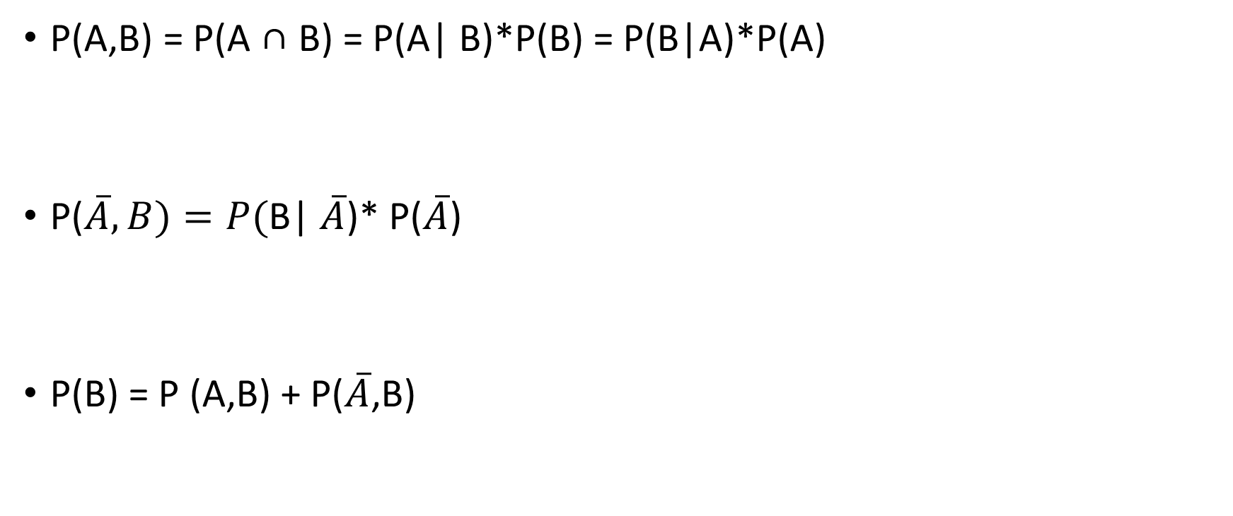
Probability Review
P(A,B) = P(A ∩ B) = P(A| B)*P(B) = P(B|A)*P(A)
P(B| )* P()
P(B) = P (A,B) + P(,B)

Slide 128
Probability Ranking Principle (PRP)
If an IR system’s response to each query is a ranking of the documents in the collection in order of decreasing probability of relevance, then the overall effectiveness of the system to the user will be maximised

Slide 129
How to model?
D -> documents
Sample space: collection of documents indexed by search engine
Q –> query
Sample space: any query consisting of one or more terms
R -> user’s judgement of relevance ( R is a binary random variable)
Sample space: 0 or 1

Slide 130
What is the probability that a user will judge a particular document relevant to a given query?
Suppose we want to model this question, we need
P(R = 1 | D = d, Q = q) -------------Equation 1
We can write this as:
P(r | D, Q) = 1 – P (|D, Q)

Slide 131
Log Odds / Logit
Given a probability p, the logit (p) is defined as:
Logit(p) = log(p/(1-p))
Where the base of the logarithm may be chosen arbitrarily

Slide 132
Properties of log Odds or Logit
As p varies from 0 to 1, logit(p) varies from -∞ to ∞
If the odds are even i.e. p = 0.5, then logit(p) = 0
Given two probabilities p and q, logit(p) > logit (q) only if p>q
Thus log odds or logit and probability are rank equivalent

Slide 133
Modelling relevance - Assumptions
The binary independence assumption is that documents are binary vectors. That is only the presence or absence of terms in the documents are recorded
The terms are independently distributed in the set of relevant documents and they are also independently distributed in the set of irrelevant documents. The representation is an ordered set of Boolean vectors
A document is represented by a vector d = (x1, x2, …….., xm) where xt = 1 if term t is present in the document and xt = 0 if it is not.
Queries represented in similar way.

Slide 134
Notion of independence
Independence signifies that the terms in the document are considered independently from each other and no association between the terms is modelled.

Slide 135
Go back to Equation 1
P(R = 1 | D = d, Q = q) -------------Equation 1
We can write this as:
P(r | D, Q)
Also we have
P(r | D, Q) = 1 – P (|D, Q)

Slide 136
Applying Baye’s theorem
Bayes theorem is: P(A|B) = P(B|A) * P(A) / P(B)
P(r| D, Q) = P(D, Q|r)* P(r)/ P(D,Q)
And
P(| D, Q) = P(D, Q| ) * P()/ P(D,Q)

Slide 137
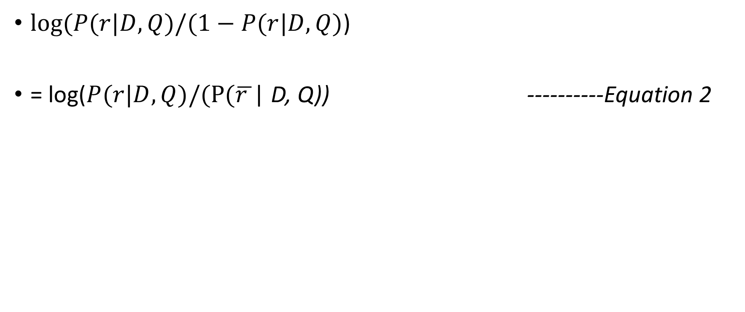
Taking log odds of equation 1

Slide 138
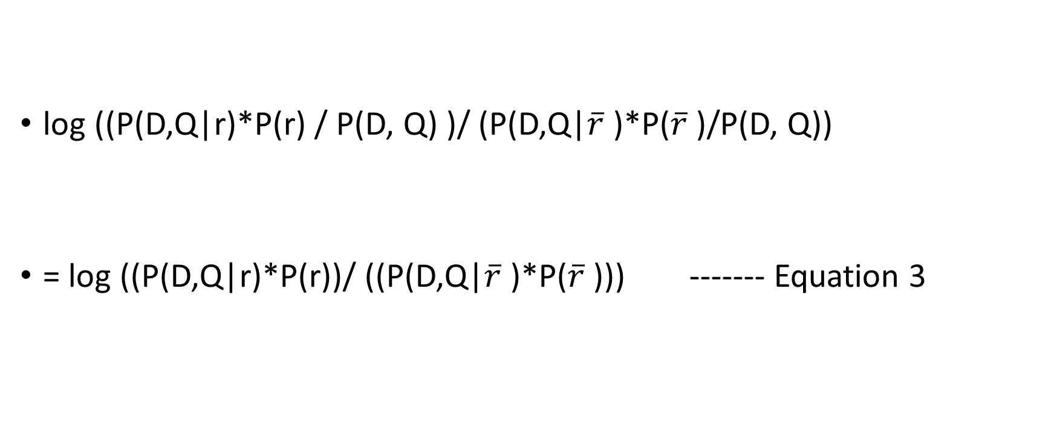
Applying Baye’s theorem equation 2 becomes

Slide 139
We may expand the joint probabilities in equation 3 into conditional probabilities by using the equality
P(D,Q|R) = P(D|Q,R). P(Q|R)
log ((P(D,Q|r)*P(r))/ ((P(D,Q| )*P( )))
= log ((P(D|Q , r)*P(Q|r)*P(r))/ ((P(D|Q, ) P(Q| )*P( )))
= log ((P(D|Q , r)*P(r|Q)*P(Q))/ ((P(D|Q, ) P( |Q)*P(Q)))
= log ((P(D|Q , r)*P(r|Q))/ ((P(D|Q, ) P( |Q)))
=log ((P(D|Q , r)/ (P(D|Q, )) + log (P(r|Q)/ P( |Q))
= log ((P(D|Q , r)/ (P(D|Q, )) This term is independent of D. Hence can be safely ignored for ranking purposes

Slide 140
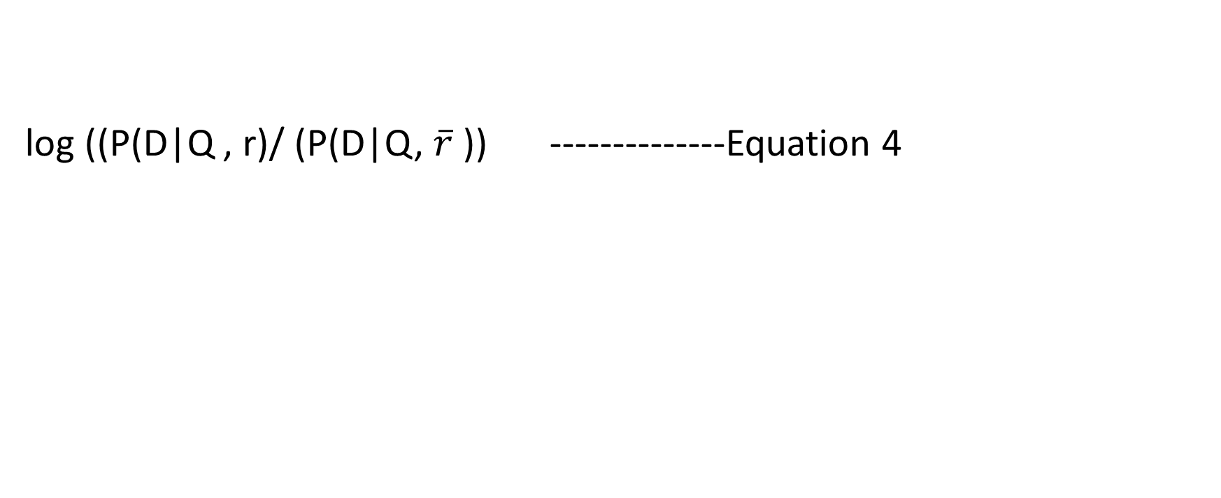
So we get to the ranking formula
log ((P(D|Q , r)/ (P(D|Q, )) --------------Equation 4

Slide 141
The Binary Independence Model – 1st assumption
Given relevance terms are statistically independent
Given a positive relevance judgement, the presence or absence of one term does not depend on the presence or absence of any other terms
Given a negative relevance judgement, the presence or absence of one term does not depend on the presence or absence of any other terms
With this assumption, we rewrite the probabilities of equation 4 as

Slide 142
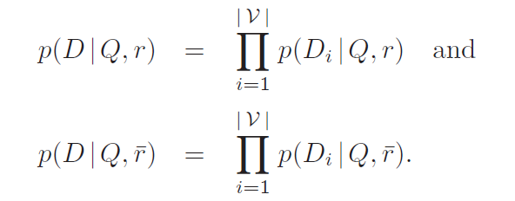

Slide 143
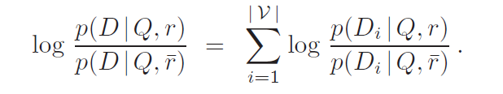
So equation 4 becomes :
-----Equation 5

Slide 144
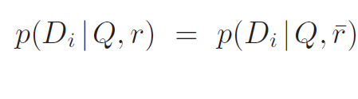
BIM-We make the second strong assumption
The presence of a term in a document depends on relevance only when the term is present in the query
As a result of this 2nd assumption, if qi = 0, then

Slide 145
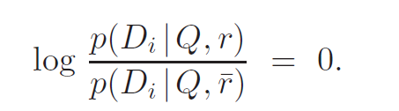

Slide 146
The effect of this assumption is to change the summation in Equation 5 from a summation over all terms in the vocabulary to a summation over all terms in the query. Because conditioning on the query is now redundant, we can drop it and our ranking formula then becomes
------ Equation 6

Slide 147
We now subtract from Equation 6 its own value when no query terms appear in the document
We can subtract this constant as it has no impact on ranking
When all query terms are absent, this term is a constant

Slide 148
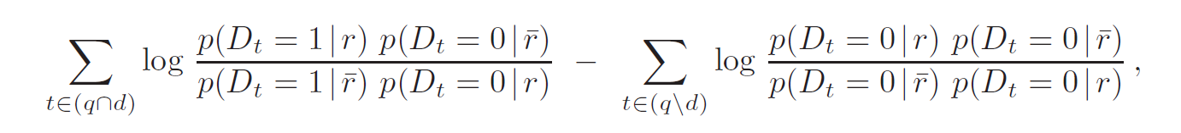
Rearranging the terms
This term is 0

Slide 149
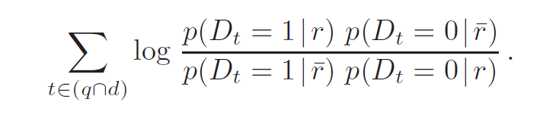
So our formula becomes !
So, this refinement of the equation 4 under the assumptions 1 and 2 and considering only the presence an absence of terms is called as the Binary Independence model

Slide 150
Thank You !

